Slide 1




TEAM ASTROELIITE
presents
CELESTI-FEST
"STREAMLINING CAMPUS EVENTS: CONNECT, ENGAGE, SUCCEED!"
PRESENTED BY:
SHIVANGI SHARMA
HARSHIT BHATIA

Slide 2
PROBLEM STATEMENT
Managing and participating in college events often presents significant challenges due to the chaotic nature of information dissemination across multiple platforms.
This fragmentation leads to confusion among students and faculty, resulting in
poor attendance and diminished engagement. A centralized solution is needed
to streamline the entire lifecycle of campus events—from planning and resource allocation to registration, attendance tracking, and post-event feedback collection—enhancing communication and fostering a more engaged campus community.

Slide 3
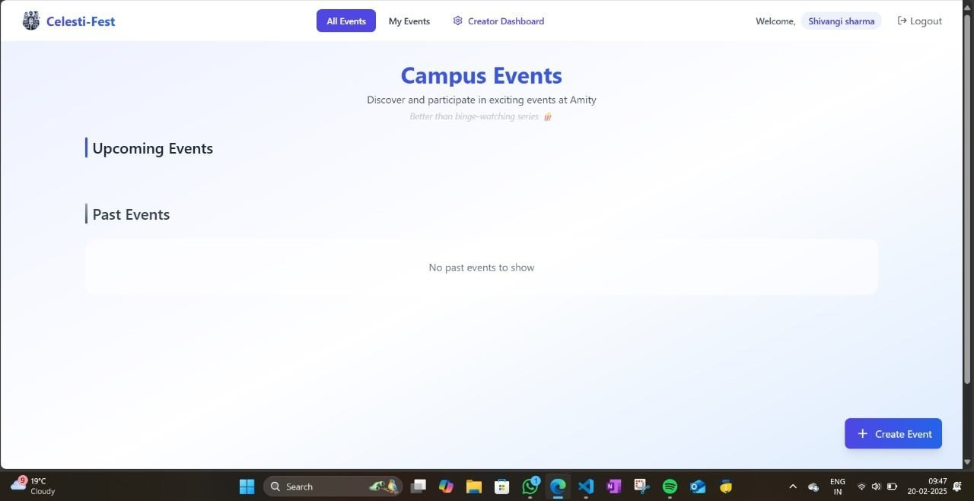
OUR SOLUTION
Celesti-Fest is an innovative project website designed to facilitate seamless integration and management of events occurring within a college environment.
Our platform serves as a centralized hub for all campus activities, ensuring that students, faculty, and administrators can easily access and engage with the vibrant array of events hosted by the institution.

Slide 4
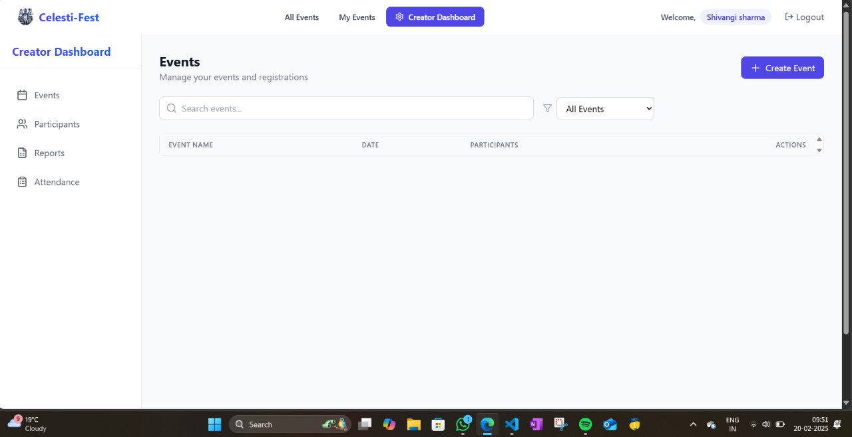
KEY FEATURES
Event Creation and Management
Admin Control-->This creator dashboard helps to create new events, see the number of participants registering with their groups, see the attendance , and also helps to download the final report of all the participants in the event.

Slide 5
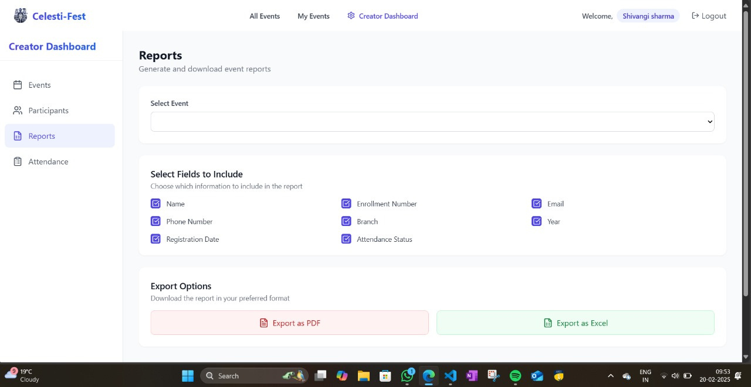
Reports->This creator dashboard helps to display a final file which includes the name, enrollment, email,
phone number etc. of all the users in a document.

Slide 6
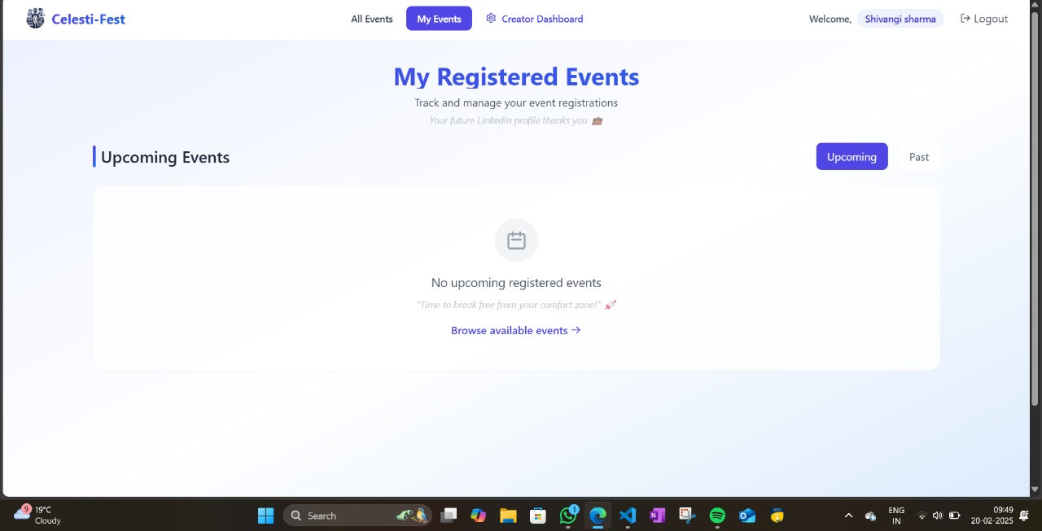
My Registered Events--> a place where a person can see all the events registered by him.

Slide 7
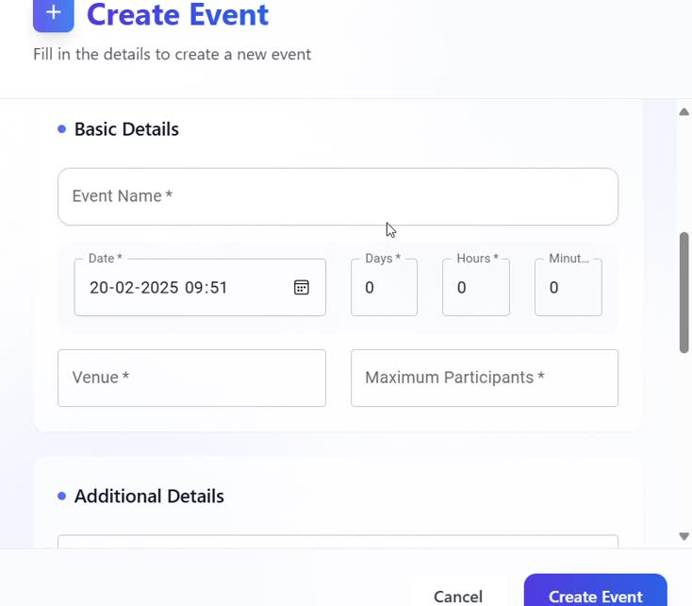
Listing an event on the website
(Live Demonstration)

Slide 8
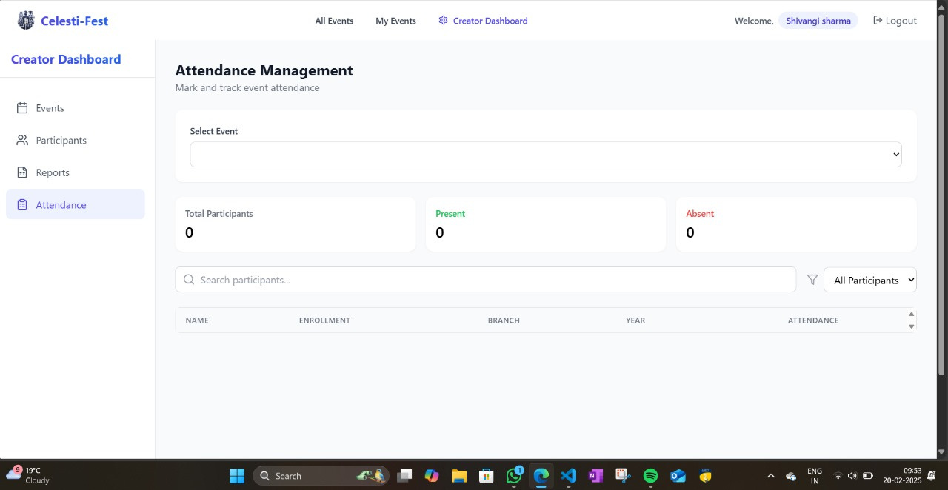
Attendance Management

Slide 9



FUTURE IDEAS
Adding Payment Gateways
Users can choose from a variety of payment methods, including digital wallets like Google Pay, as well as Razorpay for online transactions.
Additionally, we support credit and debit card payments, catering to a wide audience and accommodating different user preferences.
Upon successful completion of a transaction, users receive instant confirmation, ensuring transparency and allowing them to keep track of their payments effortlessly.

Slide 10
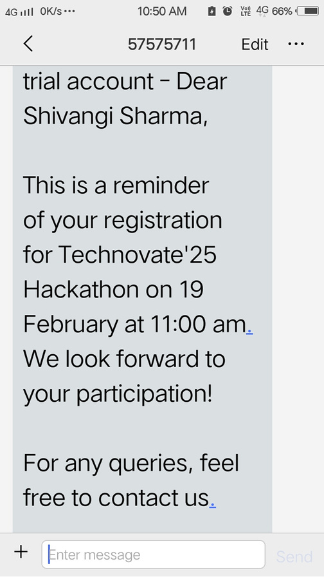
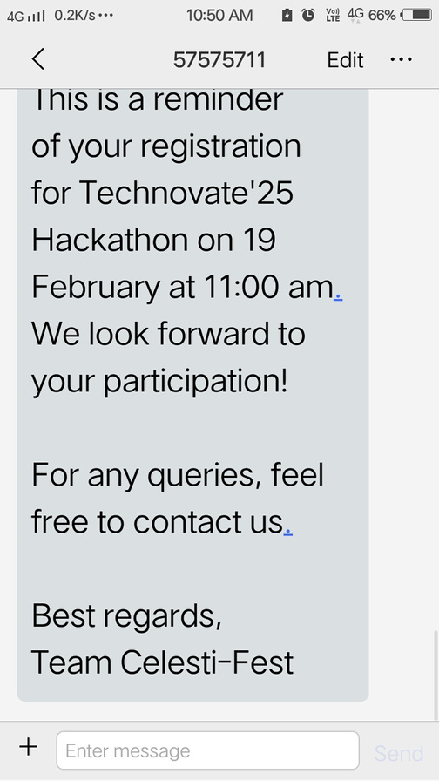
Using Twilio as a reminder and sending invitation greetings to the participants and giving feedback forms to them

Slide 11


